Slide 1
Comparison of NOBO Resource Selection at Varying Spatial and Temporal Scales
Figures using dwplot() in the ggplot2 package in R

Slide 2
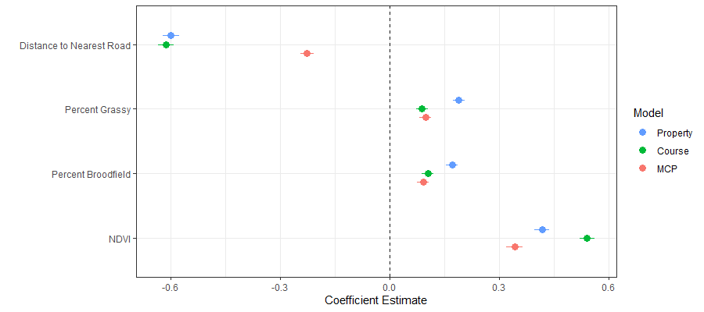
Spatial: Home-range, Course, Property

Slide 3
Temporal
Annual
Non-breeding vs breeding
Seasonal
2 Month Interval
1 Month Interval

Slide 4
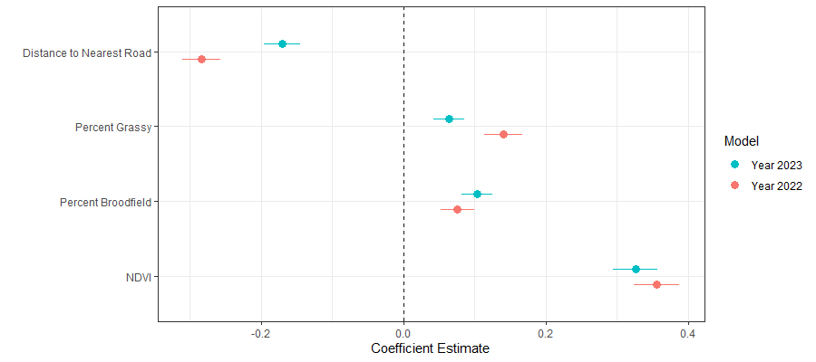
MCP: Annual

Slide 5
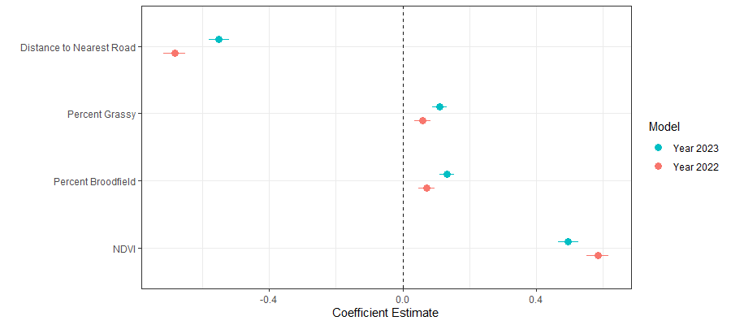
Course: Annual

Slide 6
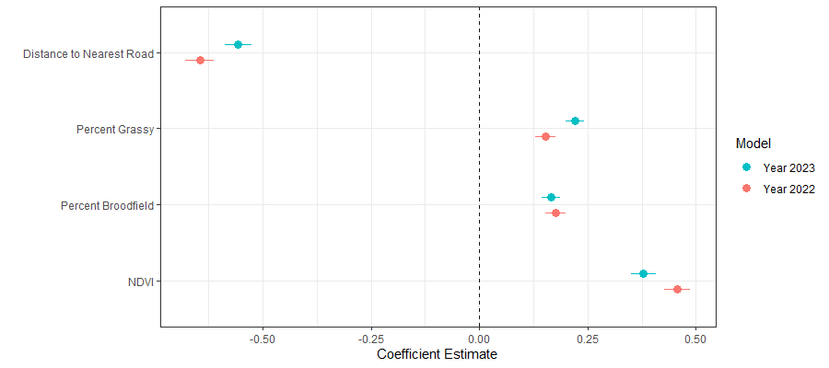
Property: Annual

Slide 7
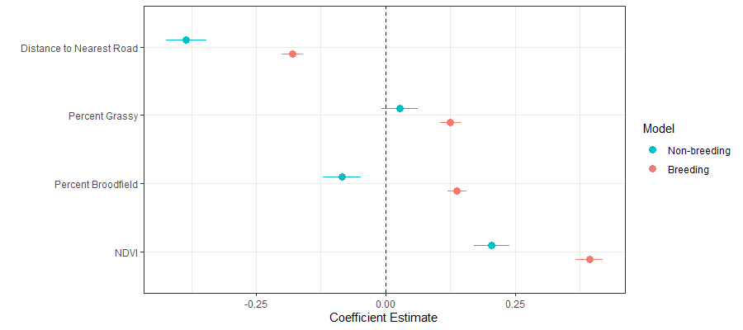
MCP: Breeding vs Non-breeding

Slide 8
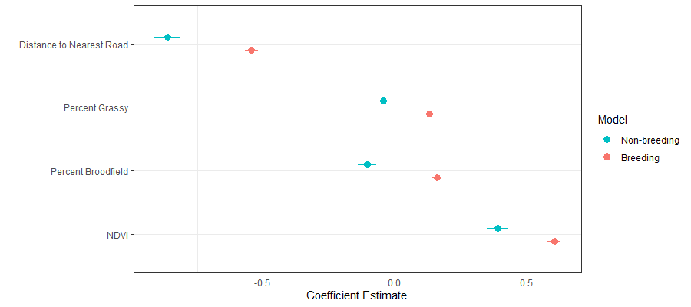
Course: Nonbreeding vs Breeding

Slide 9
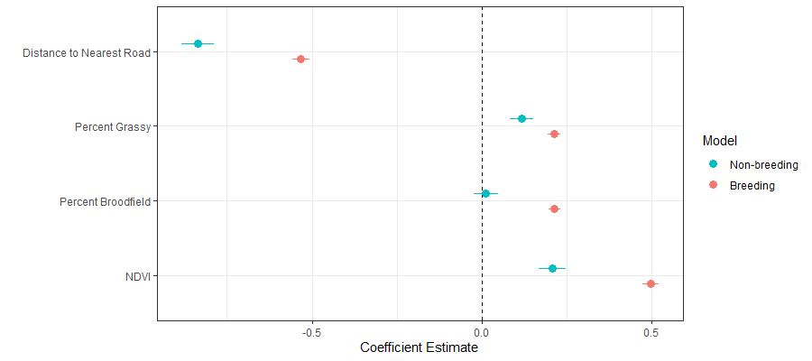
Property: Breeding vs Nonbreeding

Slide 10
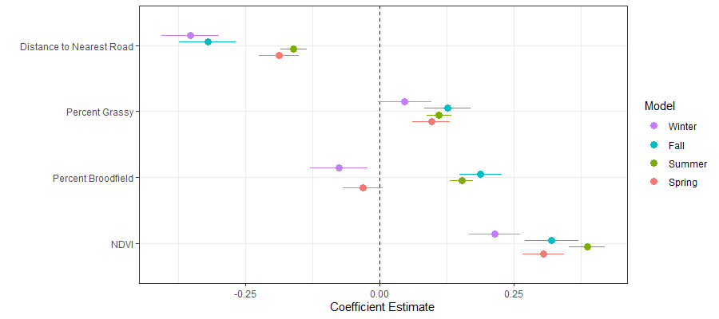
MCP: Seasonal

Slide 11
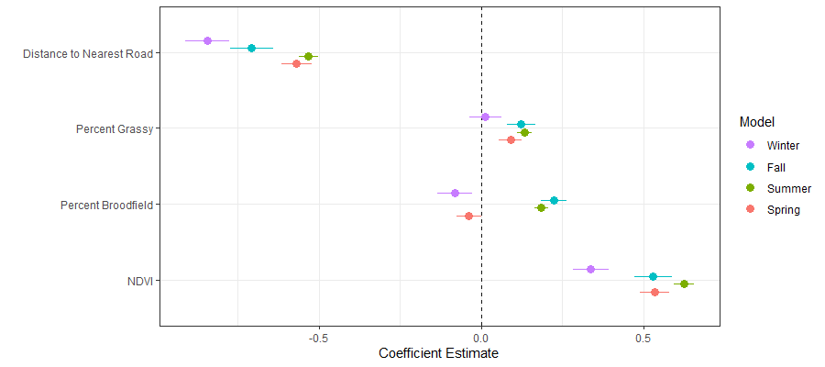
Course: Seasonal
Notes:
Meteorological Seasons# spring runs from March 1 to May 31; summer runs from June 1 to August 31; fall# (autumn) runs from September 1 to November 30; and. winter runs from December 1 to February 28 (February 29 in a leap year).

Slide 12
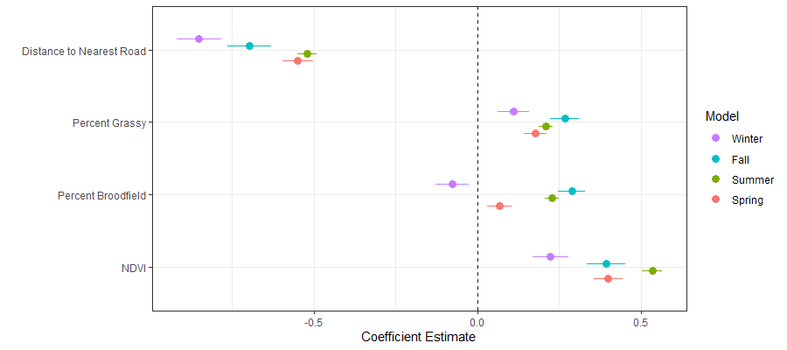
Property: Seasonal

Slide 13
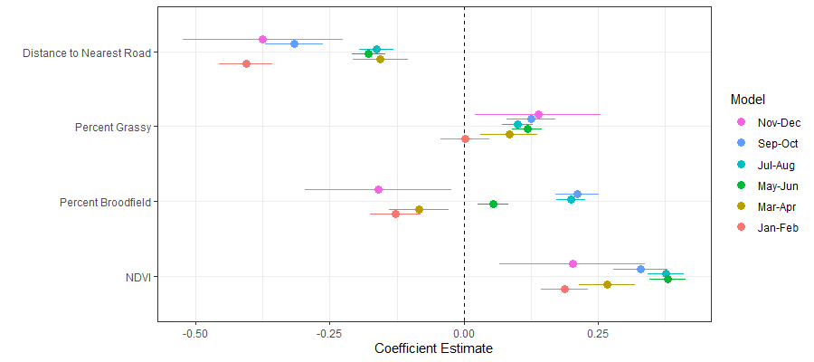
MCP: 2 Month Interval

Slide 14
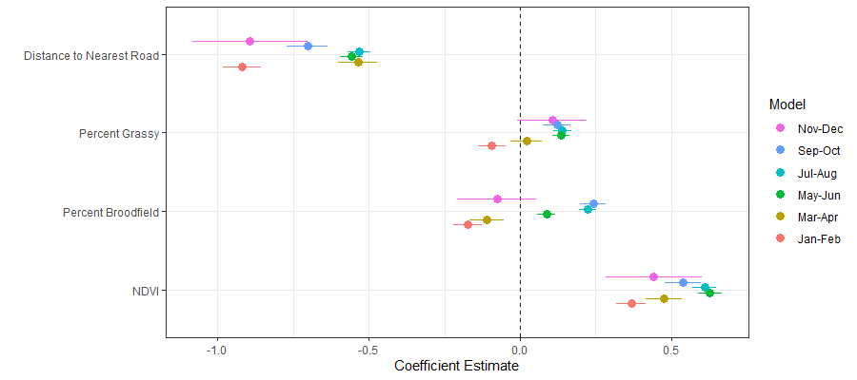
Course: 2 Month Interval

Slide 15
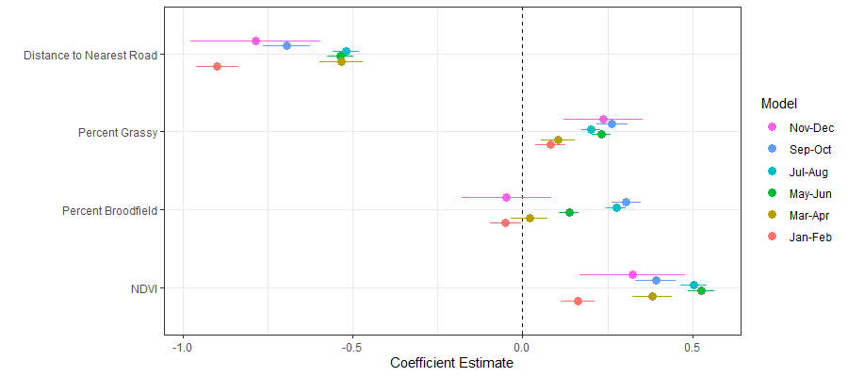
Property: 2 Month Interval

Slide 16
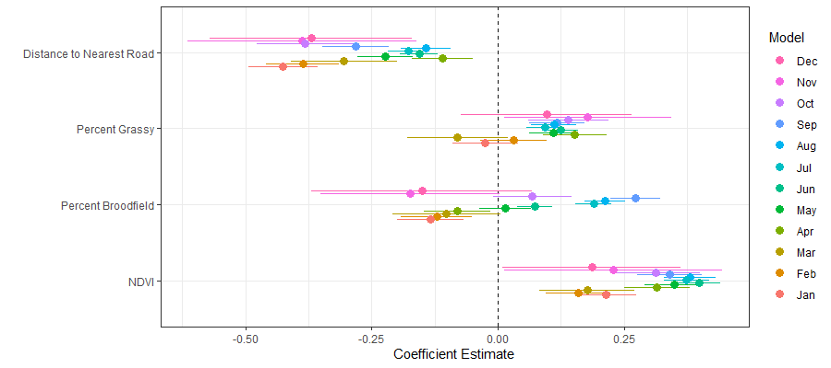
MCP: Monthly

Slide 17
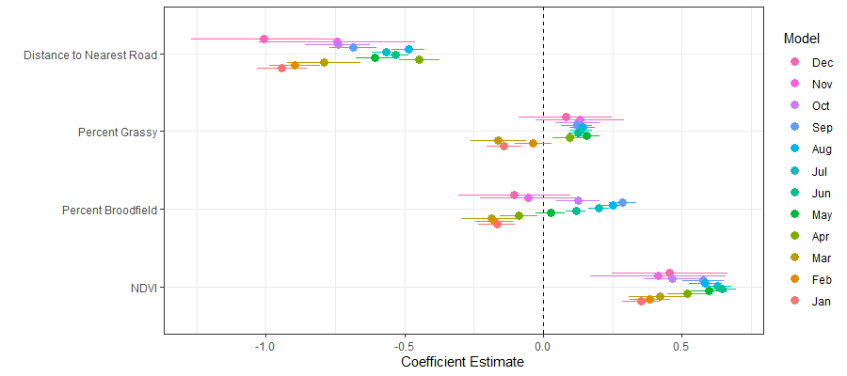
Course: Month Interval

Slide 18
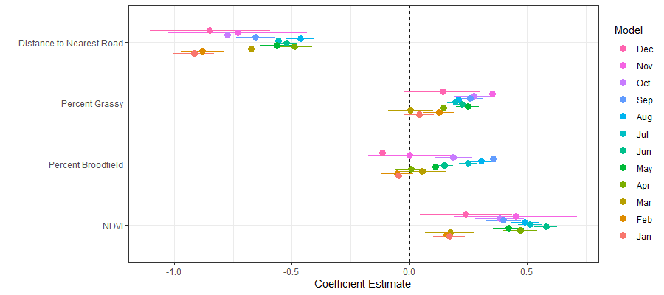
Property: Monthly

